Slide 1



National Bullying Prevention Month
October, 2020

Slide 2
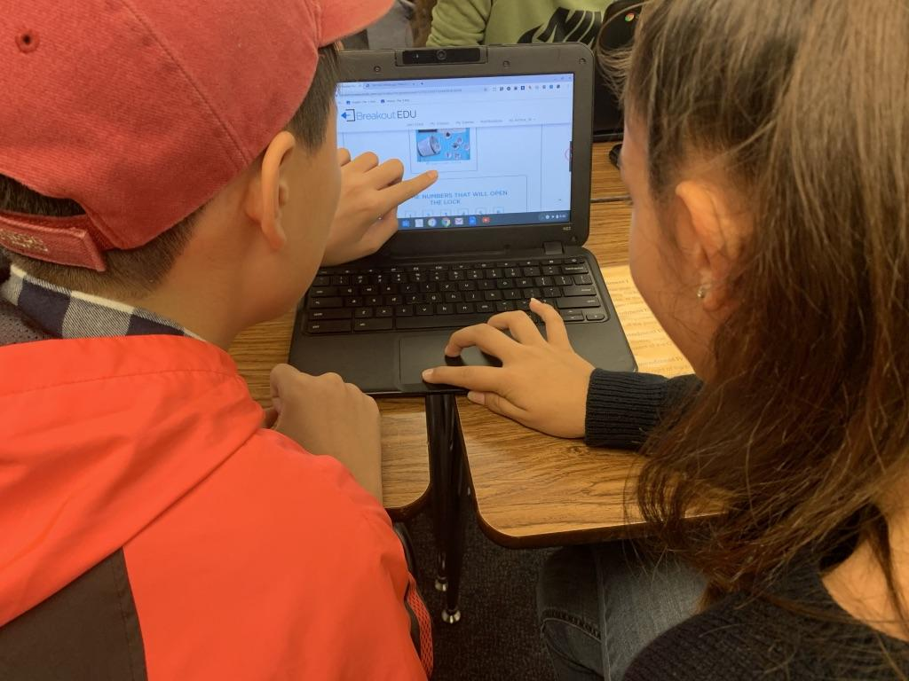
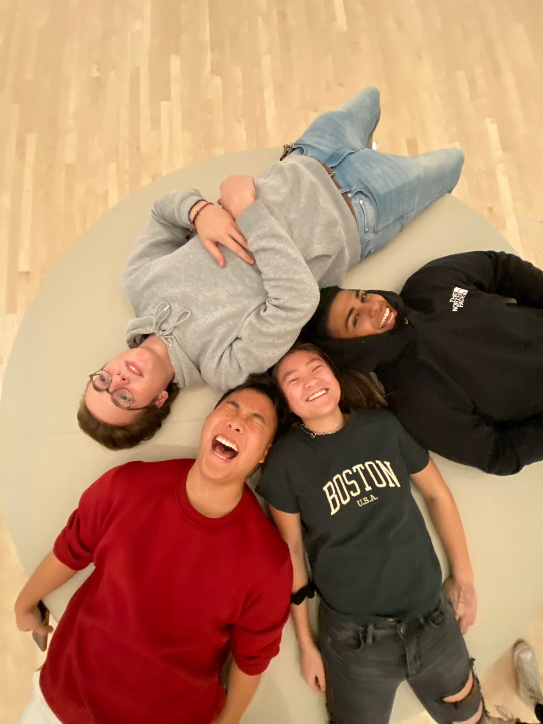
Hate, bias, and passivity toward harm to others all thrive on a lack of knowledge. We stand up for one another when we get more informed about fellow human beings and the world.
IHMS Jaguars
Mica Pollock
DVHS Wildcats

Slide 3
Stomp Out Bullying
Monday, October 5th 2020
#BlueUp - World Day of Bullying Prevention
Week of October 5th
Make friends with someone you don’t know at school
Challenge others to be kind
Week of October 12th
STAND UP for Others Week
Week of October 19th
#HereForYou & #NoOneEatsAlone - Week of Inclusion
Week of October 26th
Start the week with conversations amongst your peers

Slide 4

Pacer’s National Bullying Prevention Month
A Month Long Event to Prevent Childhood Bullying and Promote Kindness, Acceptance, and Inclusion
Choose Kindness, Acceptance, and Inclusion
#UnityDay2020 - October 21, 2020

Slide 5
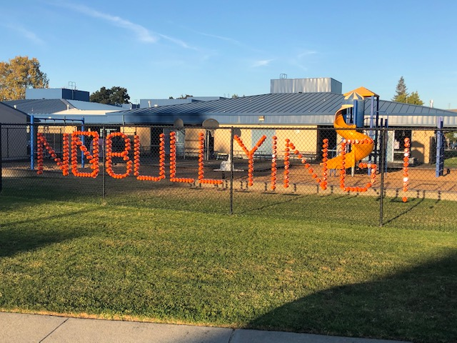
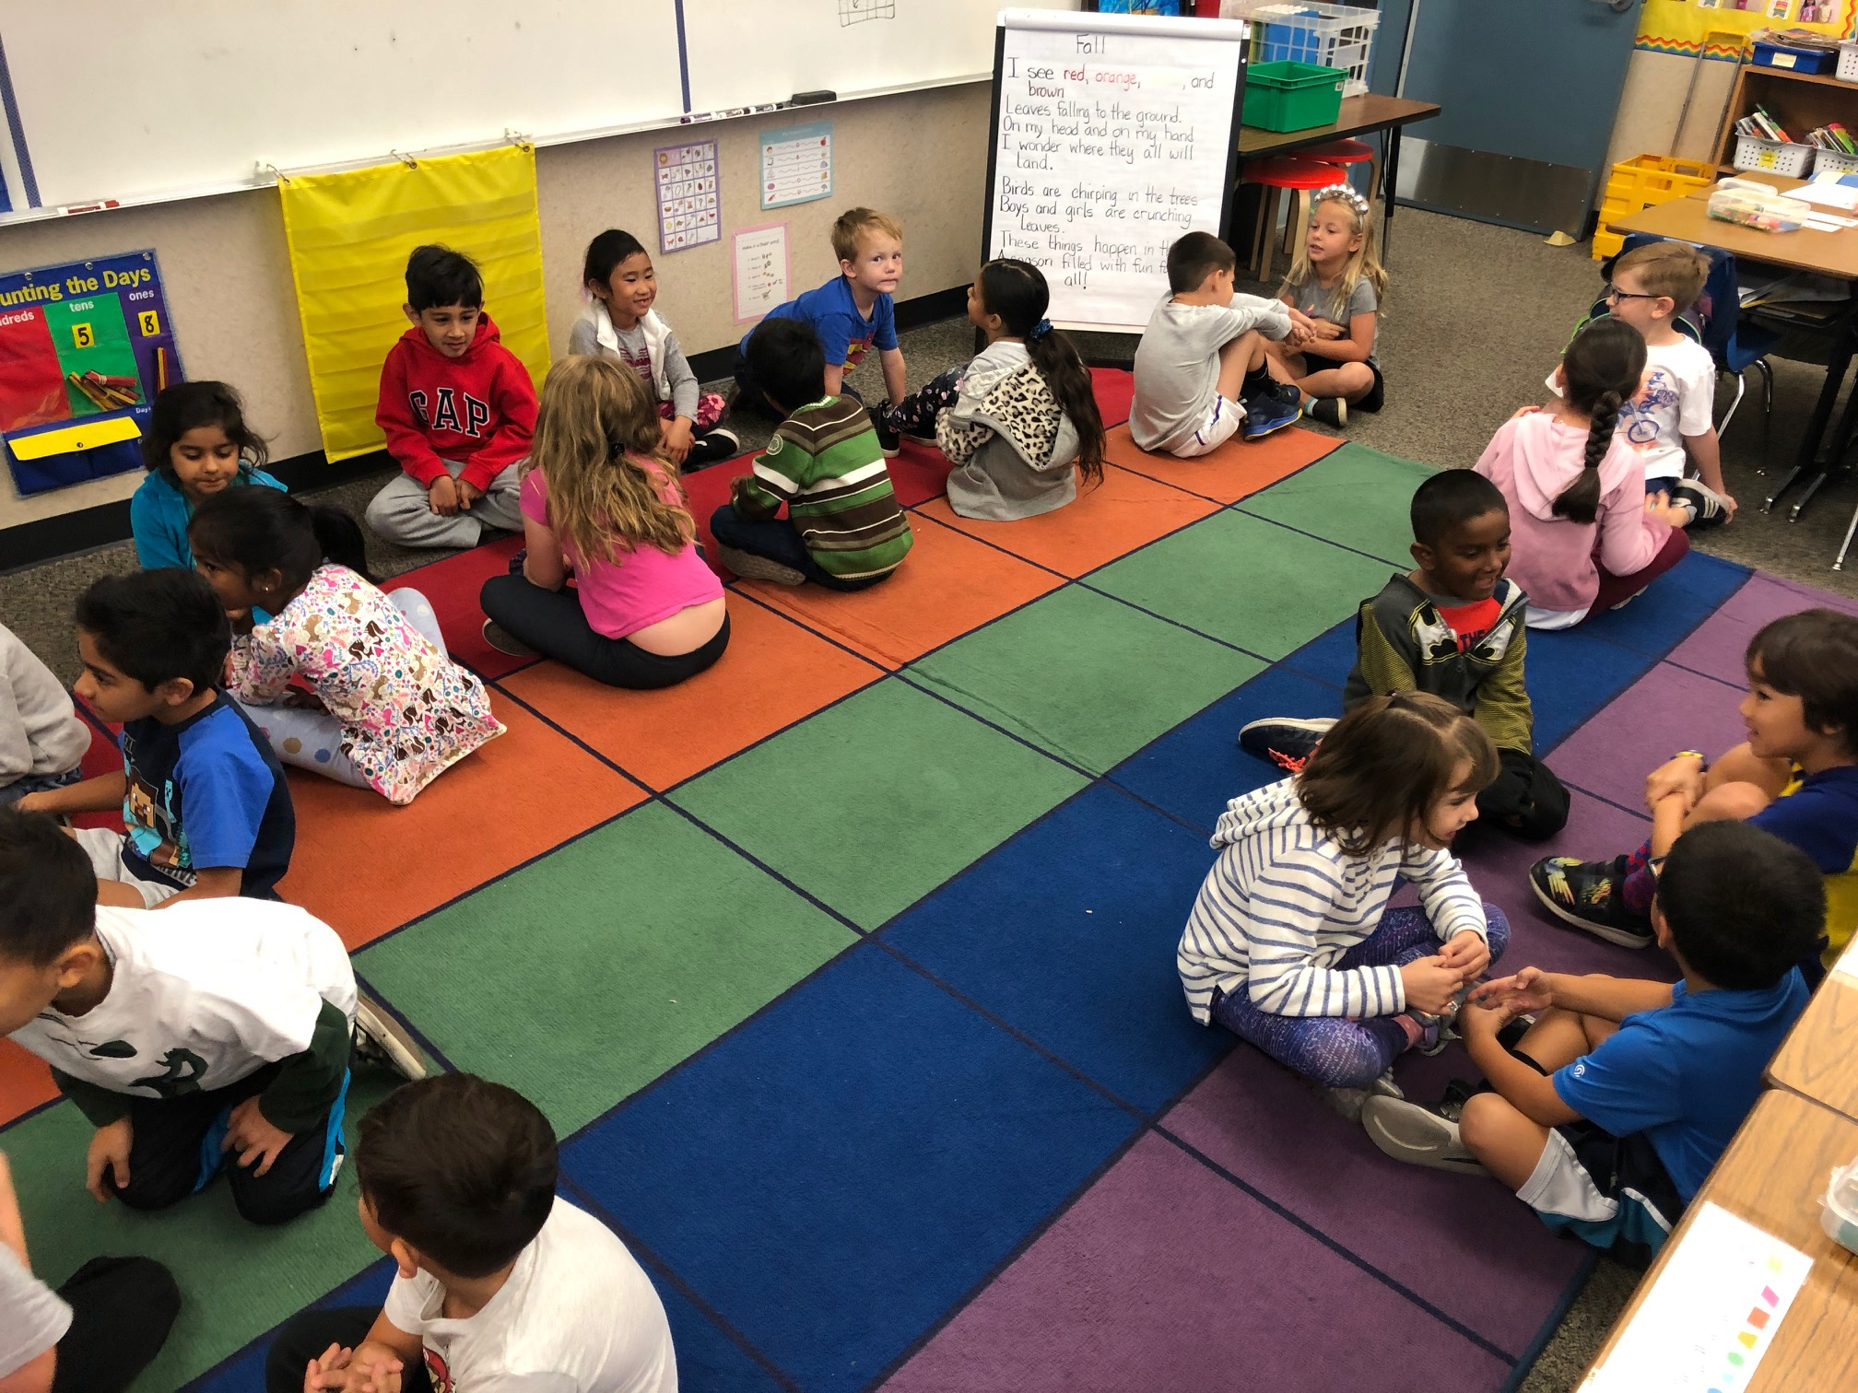
Neil Armstrong Elementary
Neil Armstrong Eagles participate in #UnityDay, 2019.

Slide 6


